Slide 1
Freight Analysis Sankey Chart

Slide 2
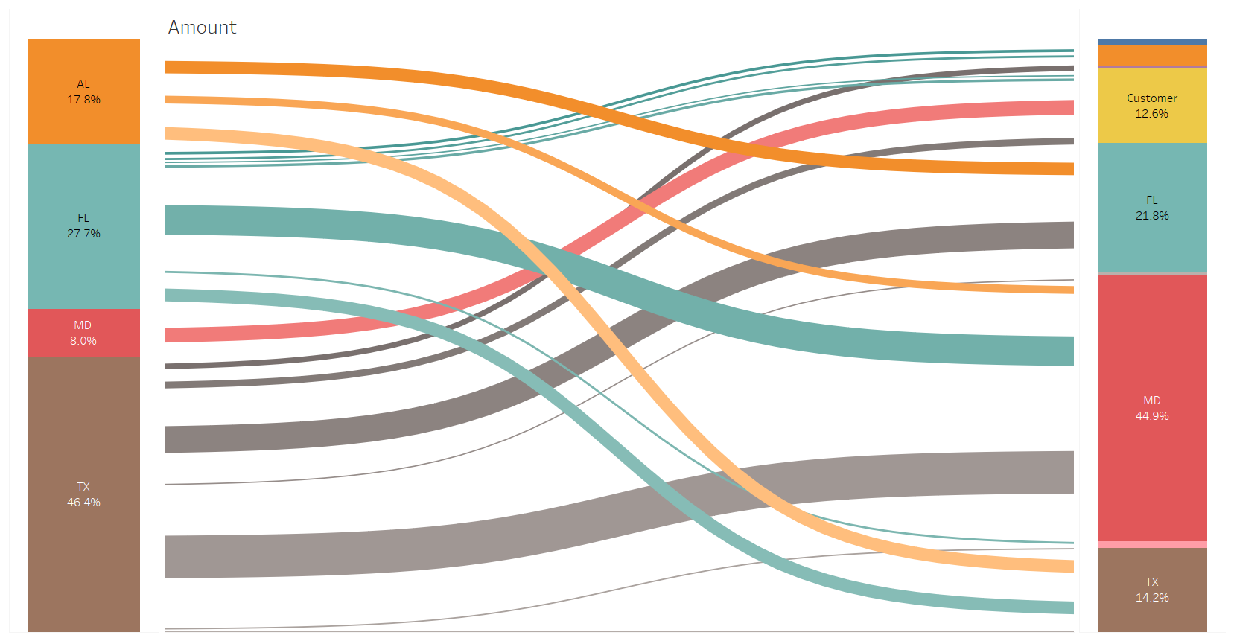

Slide 3
